Slide 1
Mask Mandate Effectiveness
Note: The scales per state may not be the same, example: New York topped out at nearly 7 deaths per 100,000 while Georgia topped out at under 1 death per 100,000.
Note: These charts represent deaths normalized by population, 1 week rolling average.
Note: Mask mandates would take 2 to 4 weeks to reflect in the death rates as they’re expected to impact new infections.

Slide 2
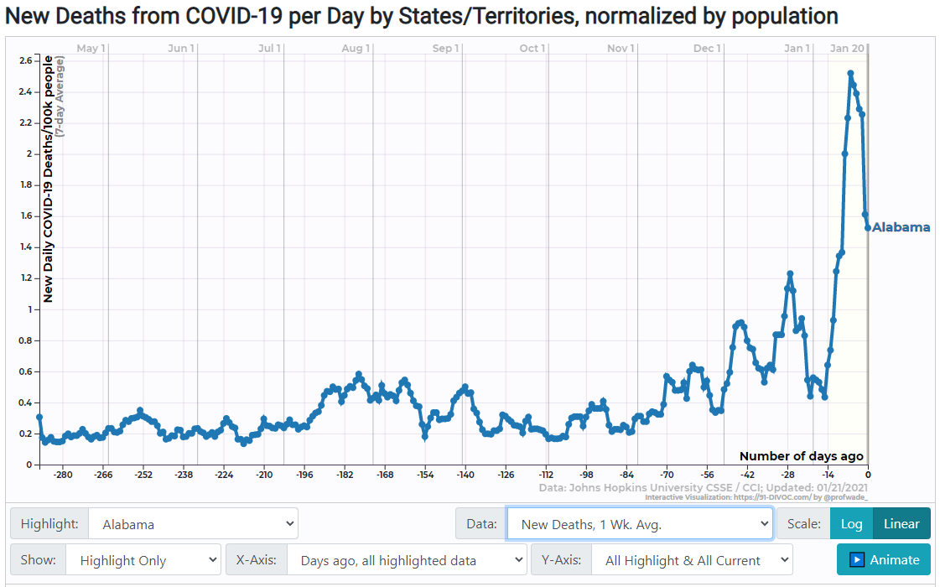
Alabama
Statewide order: Yes
The state’s mask order took effect July 16 and will now run through at least Jan. 22 following extensions by Gov. Kay Ivey. It covers people over age 6 in all indoor public spaces, and in outdoor public areas where 10 or more people are gathered. The order also mandates masks for students in second grade and up.

Slide 3
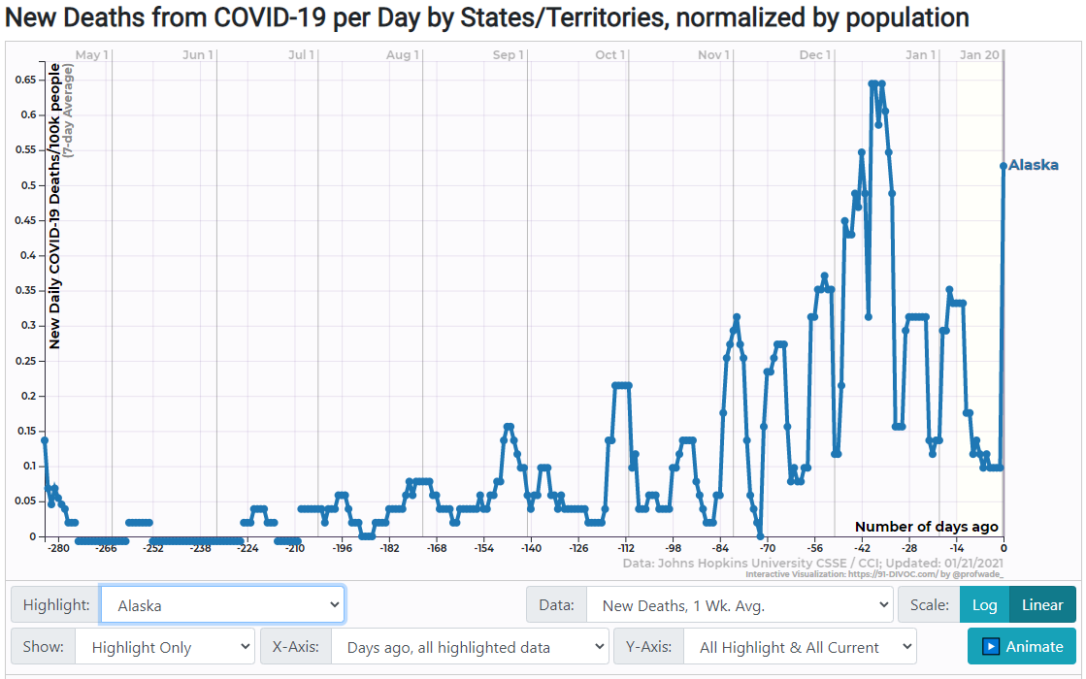
Alaska
Statewide order: No
Alaska's Department of Health Social Services “strongly encourages the wearing of masks in public,” but the state has not required it. Anchorage, Alaska's largest city, and the capital of Juneau are among several cities have have imposed local mandates.

Slide 4
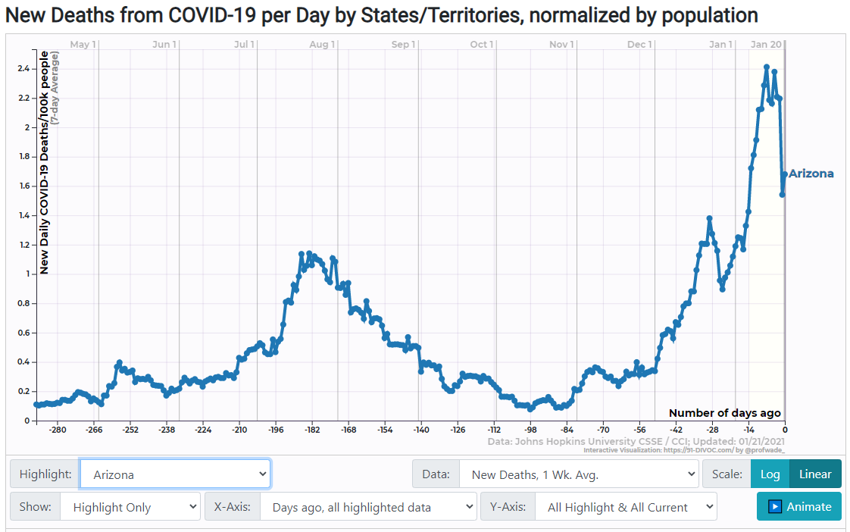
Arizona
Statewide order: No
Masks are required for employees and customers of barbers and cosmetologists. They are recommended in other circumstances. Several cities and counties have full mask orders in place, including Maricopa County, home to Phoenix, Scottsdale and Tempe, and Pima County, which includes Tucson.

Slide 5
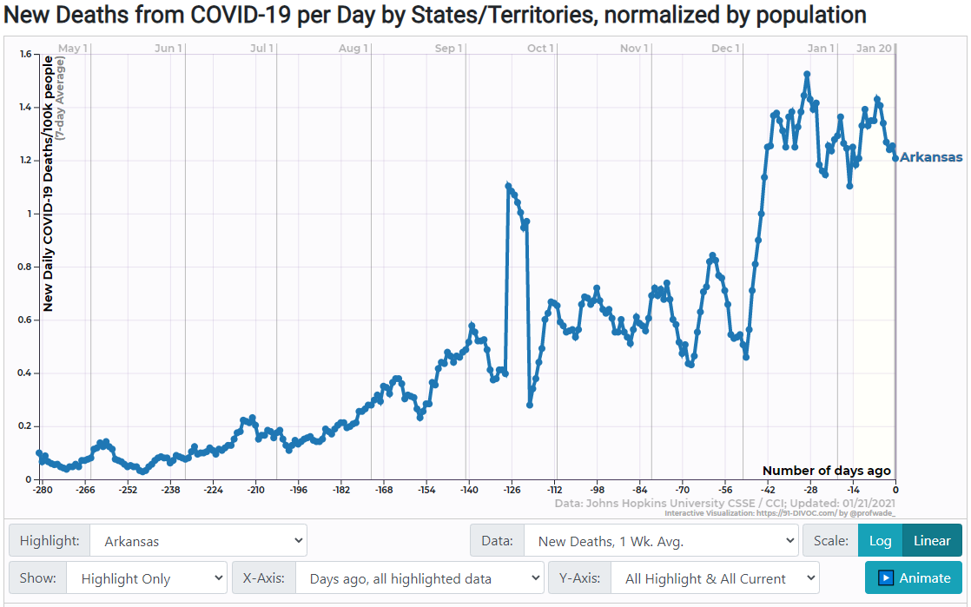
Arkansas
Statewide order: Yes
Gov. Asa Hutchinson announced a statewide mask mandate at a July 16 press briefing. The order, which took effect July 20, exempts children under the age of 10.
**No Shutdowns

Slide 6
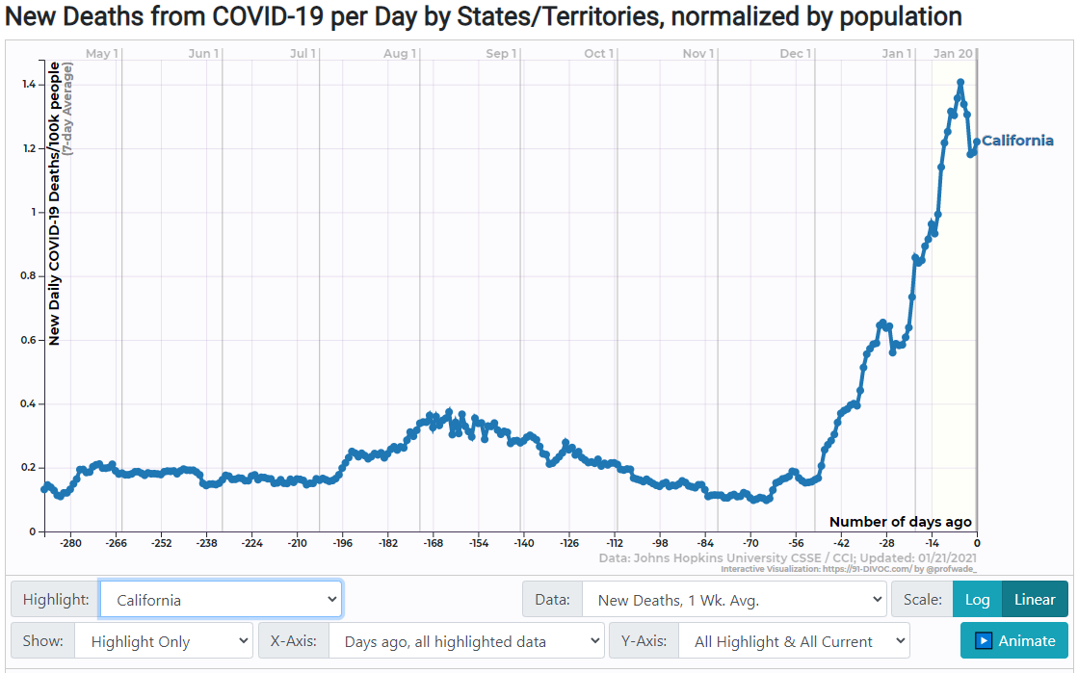
California
Statewide order: Yes
Californians have been required since June 18 to mask up in “most settings outside the home.” The policy was updated June 29 to exempt children under age 2.

Slide 7
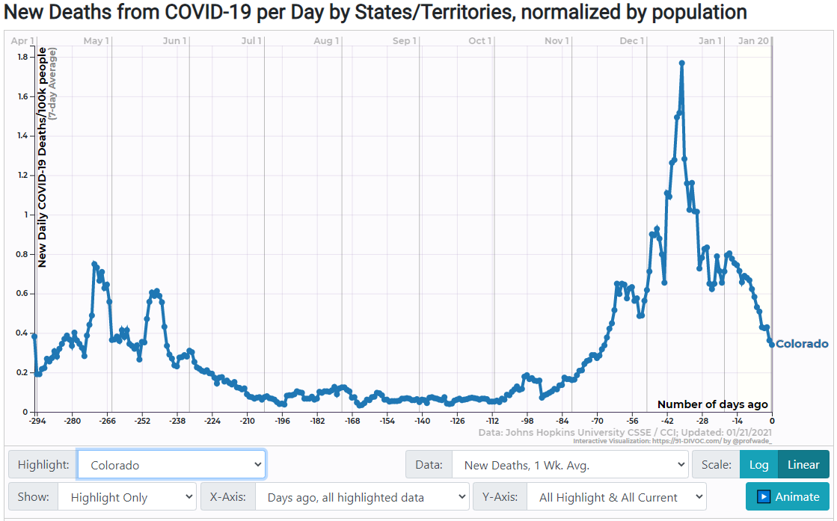
Colorado
Statewide order: Yes
Gov. Jared Polis’ order requires Coloradans over the age of 10 to wear face coverings in indoor public spaces. It took effect July 17 and has been extended until at least Feb. 4. Counties may be able to opt out if they meet state benchmarks for declining caseloads and several other public health criteria.

Slide 8
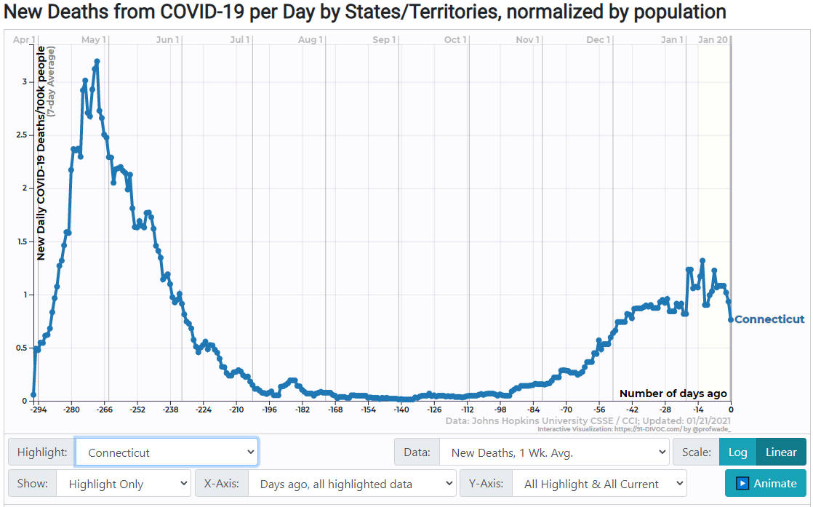
Connecticut
Statewide order: Yes
Gov. Ned Lamont's mask order issued April 17 remains in force. It requires a mask or face covering for “any person in a public place in Connecticut who is unable to or does not maintain a safe social distance of approximately six feet from every other person.” It does not cover children under age 2, or children generally when they are in a child-care setting.

Slide 9
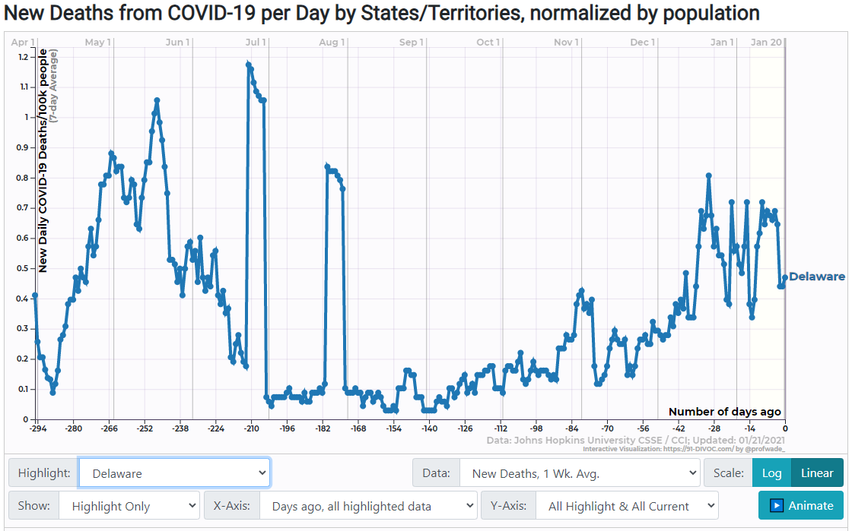
Delaware
Statewide order: Yes
A Dec. 3 update of Gov. John Carney's state-of-emergency declaration requires Delawareans to wear face coverings in all public settings and at private indoor gatherings where people from other households are present, regardless of their ability to maintain physical distance. The order, which tightened a prior mask mandate issued in April and revised in September, exempts children below kindergarten age.

Slide 10
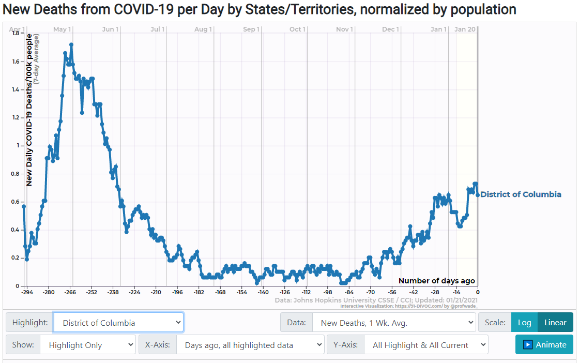
District of Columbia
Citywide order: Yes
People are required to wear masks when they leave home and “are likely to come into contact with another person” under Mayor Muriel Bowser’s July 22 order, which expanded an existing mask mandate. The new version lowers the exemption age from 9 to 2; extends the rule to common areas of apartment and condo complexes; and requires all businesses to deny entry to people without masks.

Slide 11
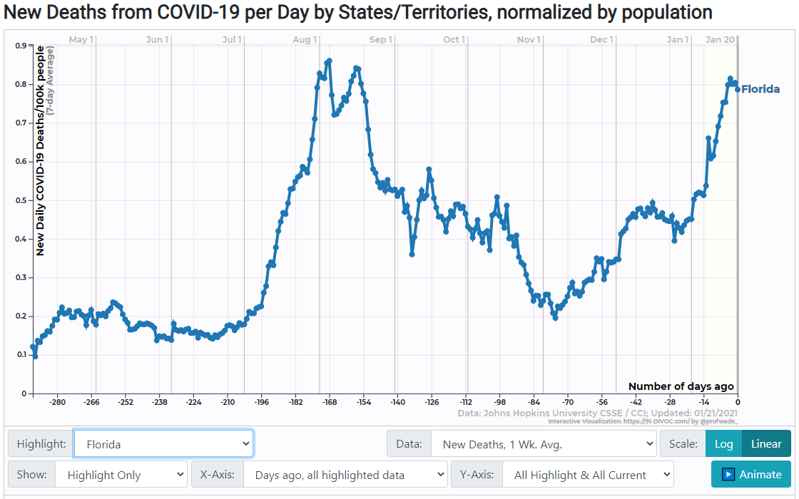
Florida
Statewide order: No
Florida recommends but does not require face coverings for the general public. Several cities and large counties, including Miami-Dade, Palm Beach and Hillsborough (which includes Tampa), have mask requirements, but local governments are barred from assessing fines and penalties for noncompliance under a Sept. 25 executive order by Gov. Ron DeSantis.

Slide 12
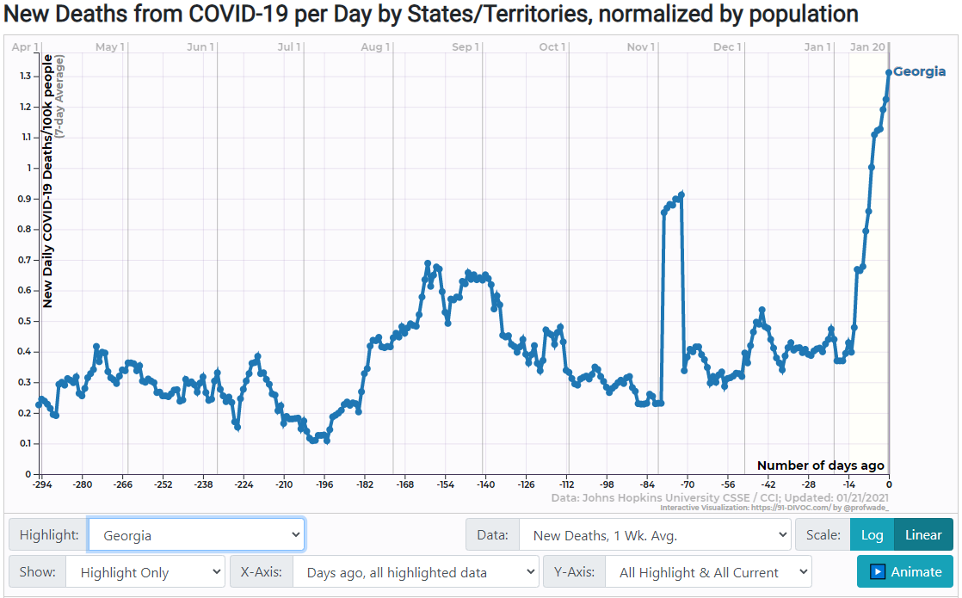
Georgia
Statewide order: No
People are “strongly encouraged to wear face coverings as practicable” outside the home. Gov. Brian Kemp revised his coronavirus health order Aug. 15 to allow local governments to impose limited mask mandates, as Atlanta and several other jurisdictions have sought to do, reversing a month-old ban on such local orders. Cities and counties that have 100 or more confirmed COVID-19 cases per 100,000 people can enforce mask requirements on public property.

Slide 13
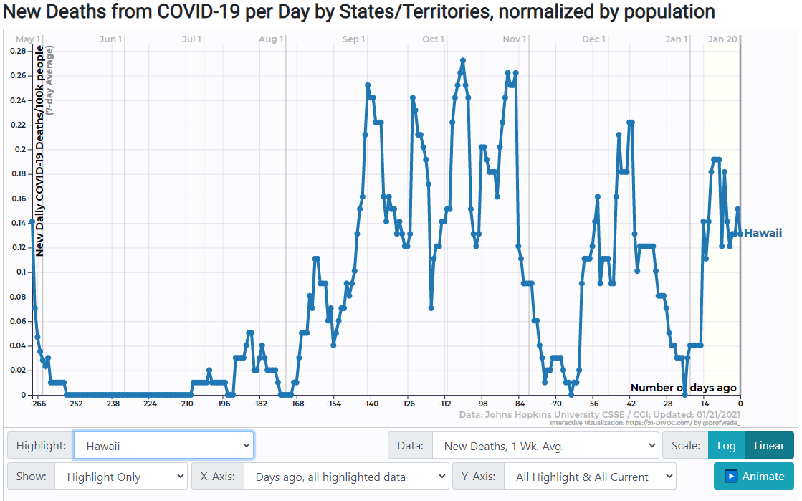
Hawaii
Statewide order: Yes
Gov. David Ige's COVID-19 emergency proclamation requires face covering for customers at or waiting to enter a place of business and for employees who have contact with customers or goods.
10 June Mask Mandate.
https://governor.hawaii.gov/wp-content/uploads/2020/06/2006097A-ATG_Ninth-Supplementary-Proclamation-COVID-19-distribution-signed.pdf

Slide 14
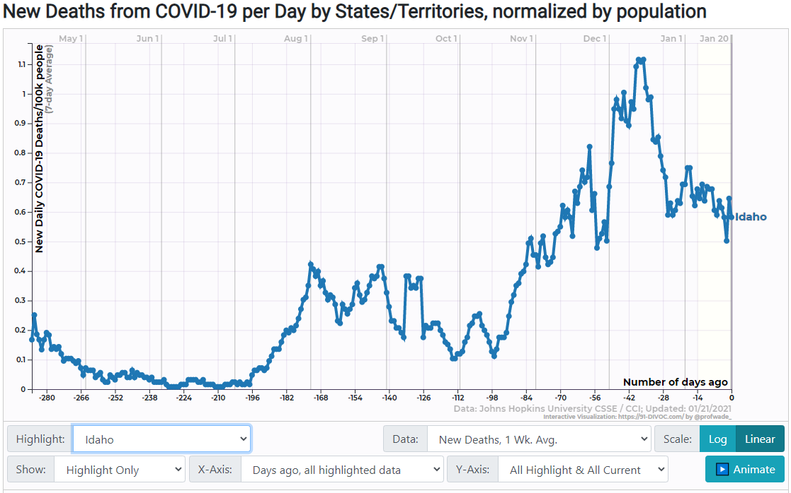
Idaho
Statewide order: No
Idaho's capital and largest city, Boise, requires masks in public, as do several other cities. The state's Stay Healthy Guidelines, updated on June 13, recommend that employers “identify how personal use items such as masks, face coverings, and gloves may be required by employees, vendors, and/or patrons."

Slide 15
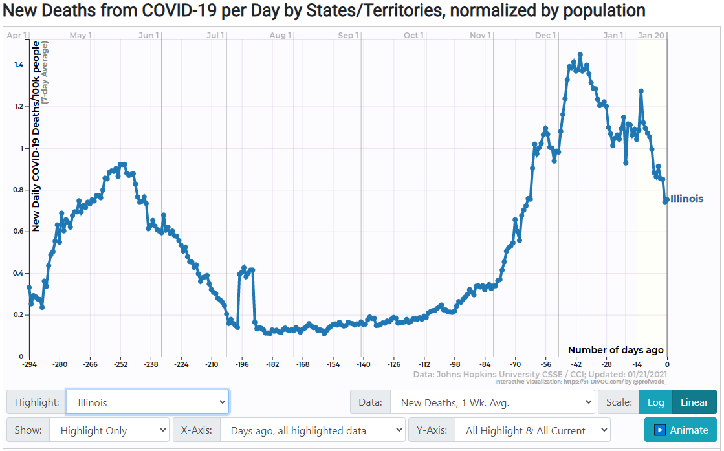
Illinois
Statewide order: Yes
Anyone who is over the age of 2 and medically able to wear a mask must do so in a public place when unable to maintain 6-foot distancing.
Mandate active 6/26
https://www.dph.illinois.gov/covid19/community-guidance/mask-use

Slide 16
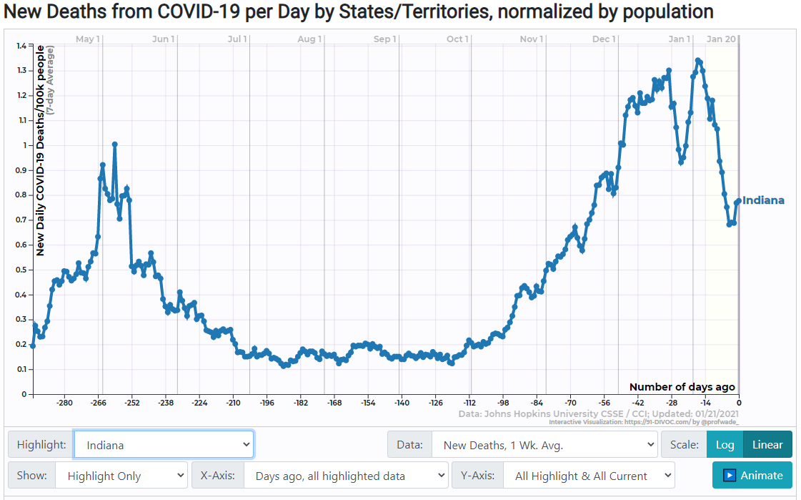
Indiana
Statewide order: Yes
Gov. Eric Holcomb’s order requiring Hoosiers age 8 and up to mask themselves in all indoor public settings and outdoors when they cannot maintain 6 feet of distance from others took effect July 27 and was renewed on Nov. 13.

Slide 17
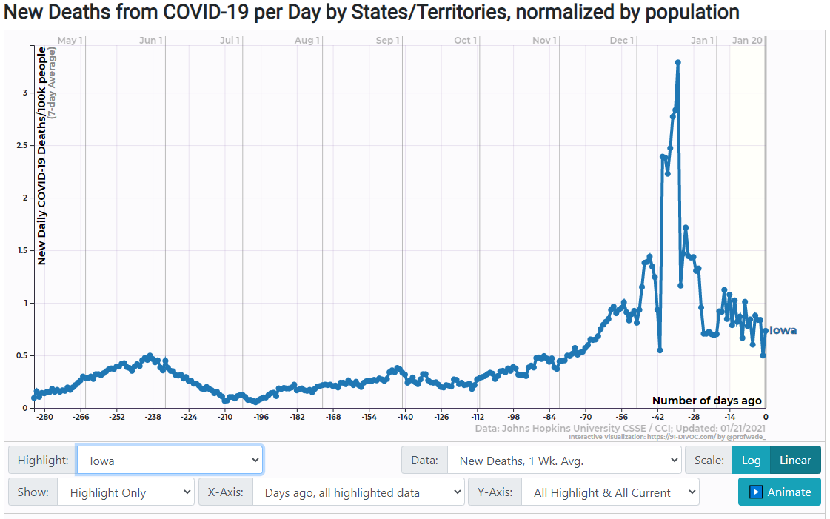
Iowa
Statewide order: Yes
Gov. Kim Reynolds announced a face-covering mandate effective Nov. 17. The governor's proclamation requires Iowans age 2 and up to wear masks when they are in indoor public spaces and within 6 feet of people from other households for 15 minutes or more. The order has been extended through at least Feb. 6.
**No Shutdowns

Slide 18
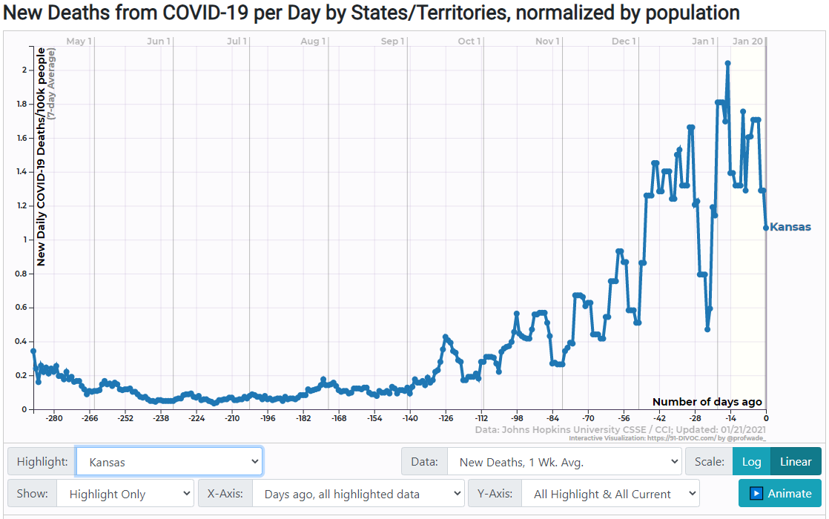
Kansas
Statewide order: Under an executive order issued by Gov. Laura Kelly in July and reissued in November, Kansans over the age of 5 must wear masks in indoor public settings and outdoors when unable to stay 6 feet apart from people from other households. A state law passed in June allows counties to opt out of the mandate. More than 60 of Kansas' 105 counties have adopted the mask rule, up from 25 before Kelly announced the second order on Nov. 18.

Slide 19
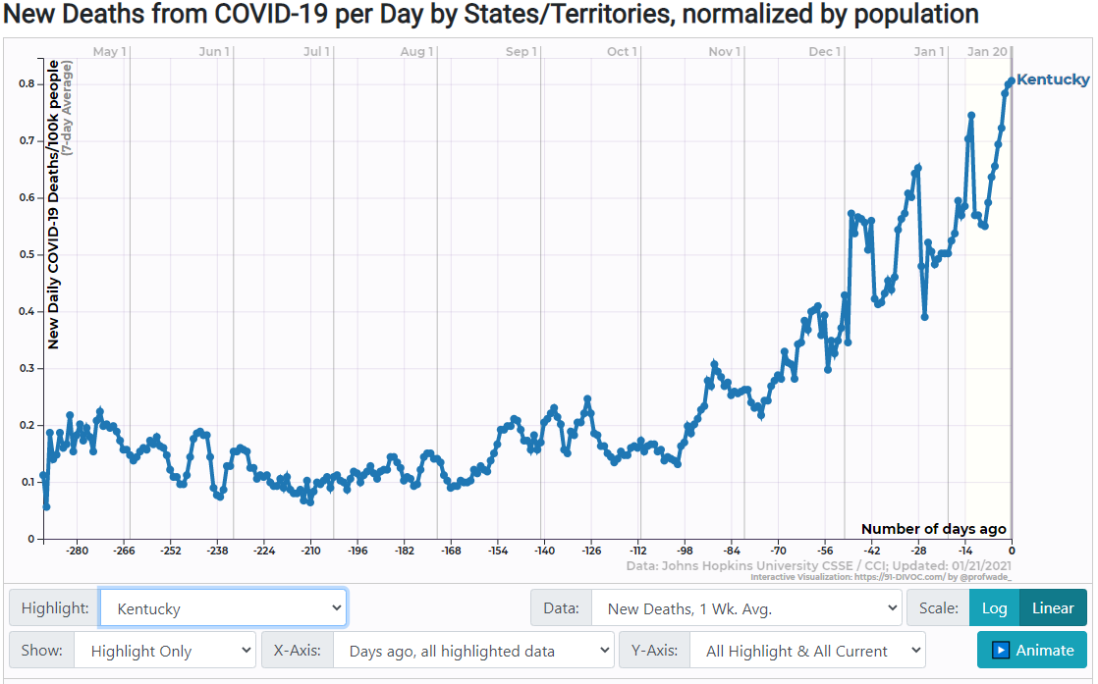
Kentucky
Statewide order: Yes
Gov. Andy Beshear's executive order requires face covering for people “in situations that represent a high risk of COVID-19 transmission,” including most public settings. The mandate, issued in July, has been extended monthly, with the current order in force through at least Feb. 2. Children age 5 and under are exempt.
7/9 Order Date
https://governor.ky.gov/attachments/20201203_Executive-Order_2020-996_Face-coverings.pdf

Slide 20
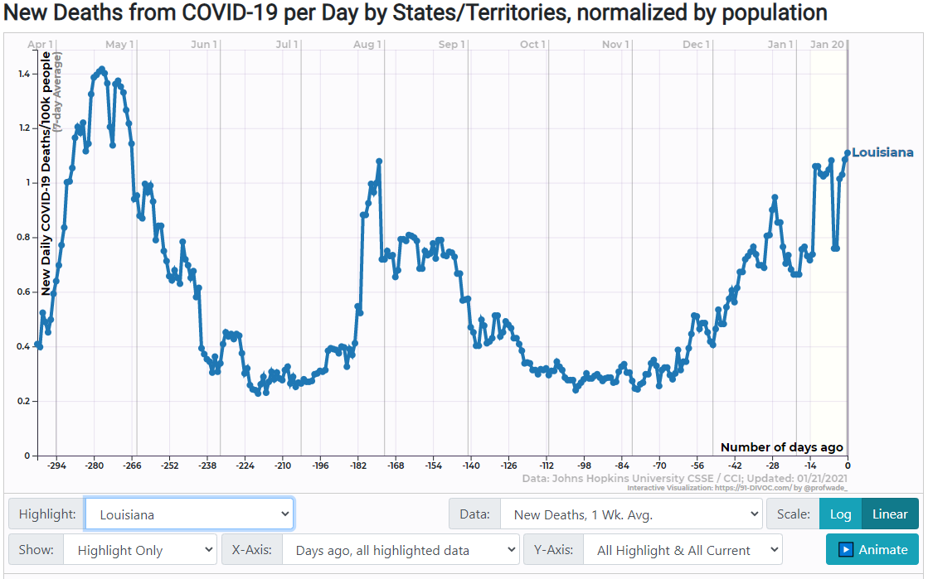
Louisiana
Statewide order: Yes
Face-covering is required in indoor and outdoor public spaces when it is not possible to maintain 6 feet of distance from people from other households, per a proclamation issued by Gov. John Bel Edwards on July 11 and extended through at least Feb. 10. The mandate does not apply to children under 8 (although it encourages masking for those age 2 to 7).

Slide 21
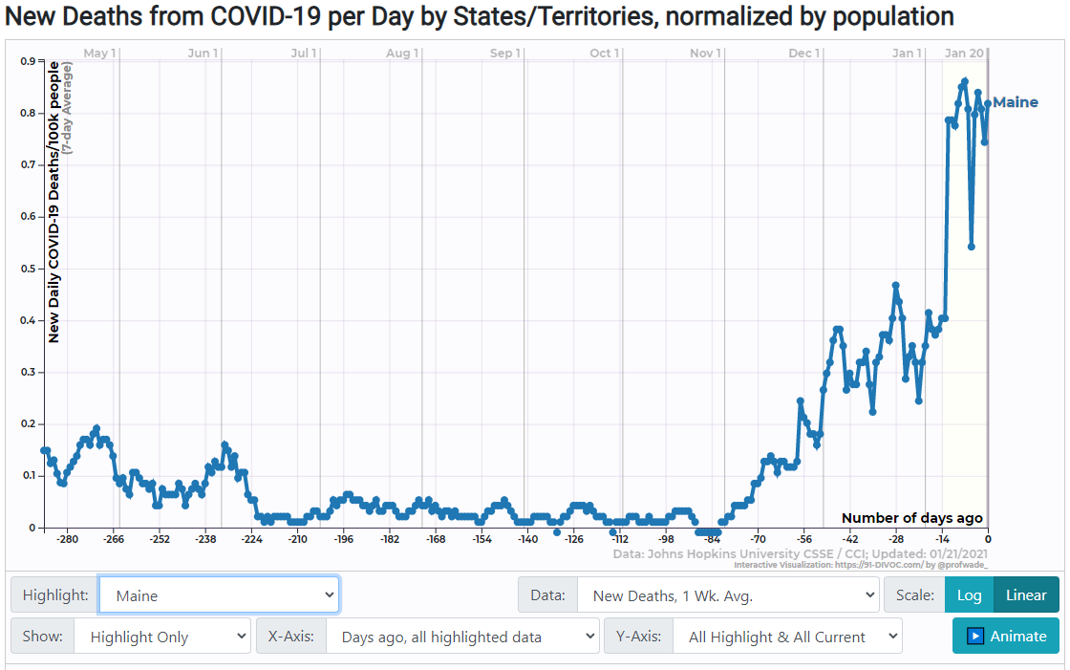
Maine
Statewide order: Yes
An executive order issued Nov. 4 by Gov. Janet Mills strengthens a state mask mandate that had been in effect since May 1. The new order requires face-covering in indoor and outdoor public spaces "regardless of the ability to maintain physical distancing." Prior orders did not apply to all public places and included an exception where distancing was possible.

Slide 22
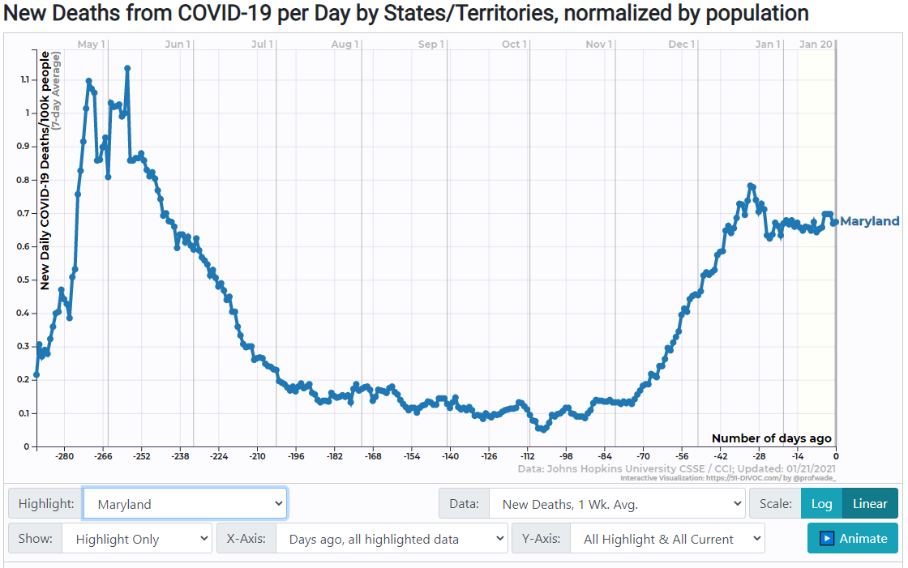
Maryland
Statewide order: Yes
Effective July 31, Marylanders over age 5 must wear masks in all indoor public spaces and outdoors when they are "unable to consistently maintain six feet of distance" from others. The order by Gov. Larry Hogan expands the state's previous mask mandate, in force since April 18, which applied to retail and food-service establishments and had an age cutoff of 9.

Slide 23
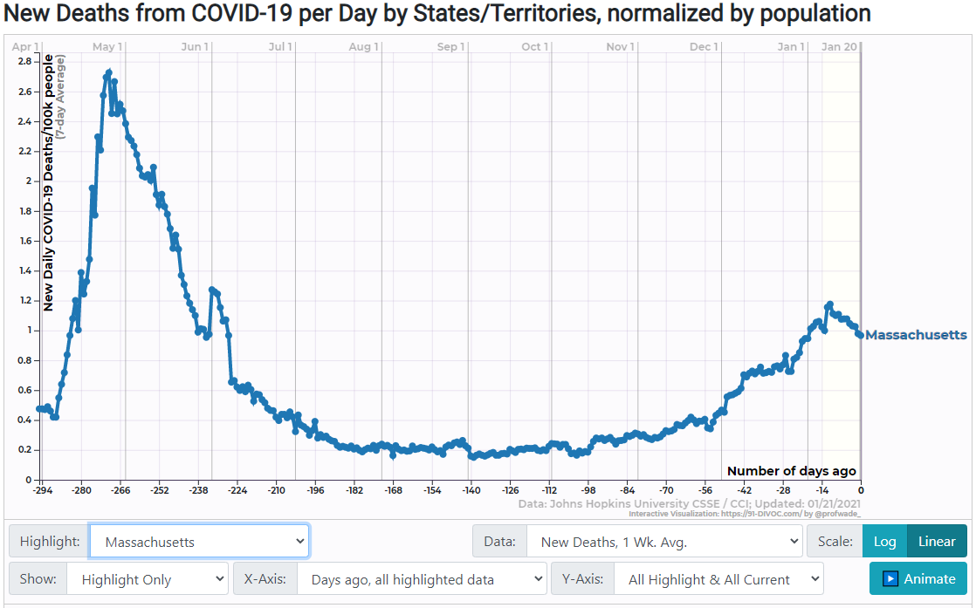
Massachusetts
Statewide order: Yes
As of Nov. 6, face coverings are required for people over age 5 in any public space, indoors or out, whether or not they are able to maintain 6 feet of distance from others. The new order, issued Nov. 2 by Gov. Charlie Baker, tightens a mandate in effect since May that required masks “where social distancing is not possible.”

Slide 24
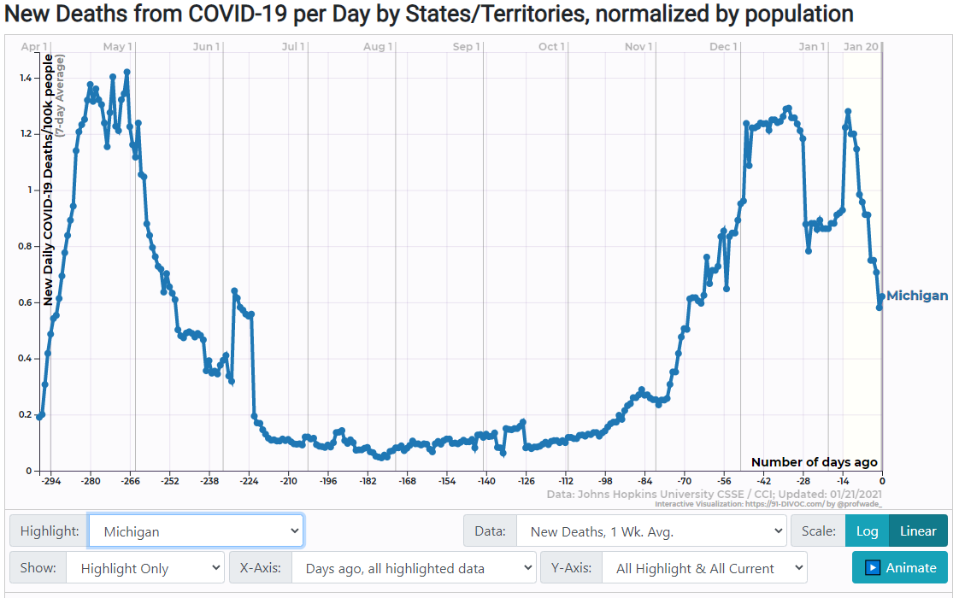
Michigan
Statewide order: Yes
Masks are required for people over age 5 and up in most public settings under an order issued Oct. 5 and renewed Oct. 29 by the state Department of Health and Human Services. It replaced a similar mandate by Gov. Gretchen Whitmer that was thrown into doubt when Michigan's Supreme Court invalidated the state law under which Whitmer had been issuing emergency public-health order.

Slide 25
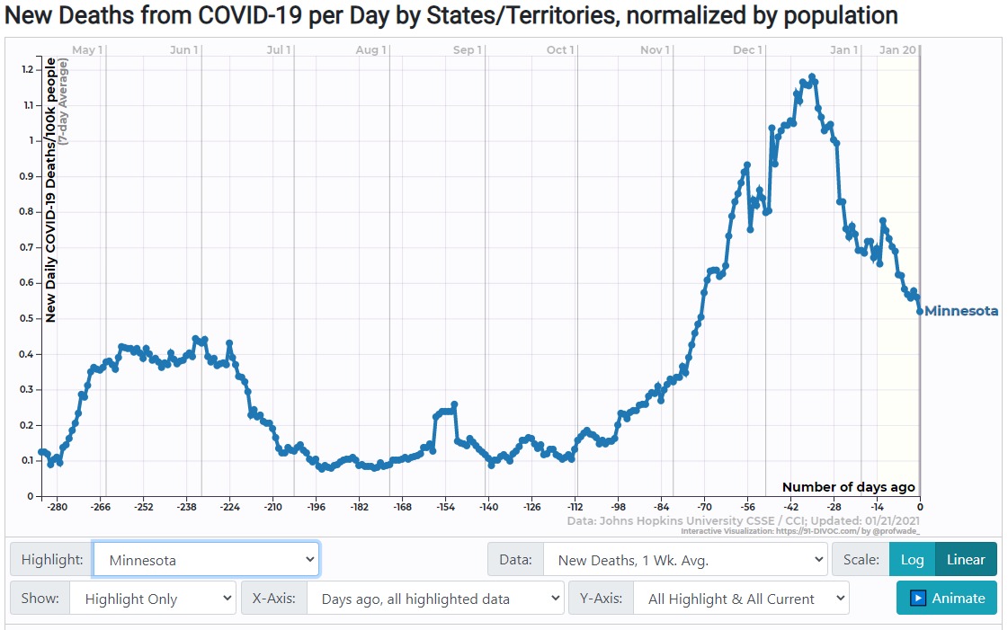
Minnesota
Statewide order: Yes
Gov. Tim Walz’s mask order took effect July 25, superseding a prior mandate that applied to employees at stores, restaurants and other consumer-facing businesses. Children age 5 and under are exempt. People are not required to wear a mask when working alone in an office or cubicle with walls above face height when social distancing is maintained, but must keep one handy for interacting with others.

Slide 26
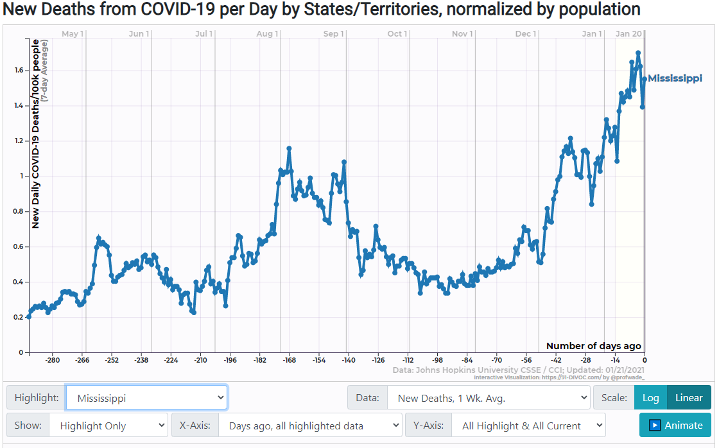
Mississippi
Statewide order: No
Gov. Tate Reeves lifted Mississippi’s mask requirement on Sept. 30, about two months after it was imposed. On Oct. 19 he issued a new order mandating masks in indoor public settings in counties with high COVID-19 case rates. The order currently covers 75 of Mississippi's 82 counties and is in effect until at least Feb. 3. Face-covering is still required statewide at schools and “close contact personal care services” such as salons, barbershops and massage parlors.

Slide 27
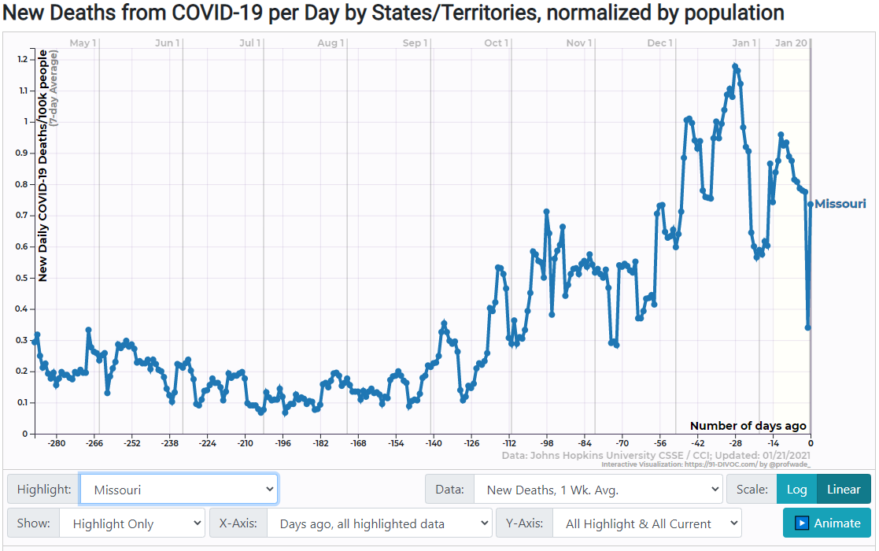
Missouri
Statewide order: No
The state Department of Health and Senior Services recommends wearing a face covering in public. Gov. Mike Parson has said he does not intend to implement a statewide requirement. Several cities and counties have enacted mask mandates, including Kansas City and St. Louis.

Slide 28
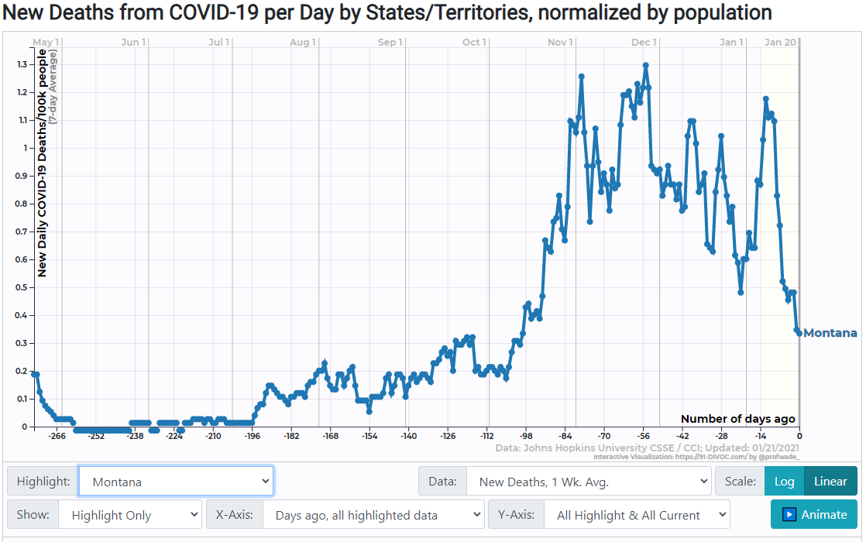
Montana
Statewide order: Yes
An executive order issued in July by then-Gov. Steve Bullock requires Montanans age 5 and up to wear masks in indoor public spaces and at any “organized outdoor activity” where social distancing cannot be maintained. The initial mandate excepted counties where there are fewer than four confirmed, active cases of COVID-19, but Bullock issued a new order on Nov. 17 that expands the mask rule to all counties, regardless of local case counts. New Gov. Greg Gianforte has said he plans to rescind the mandate.

Slide 29
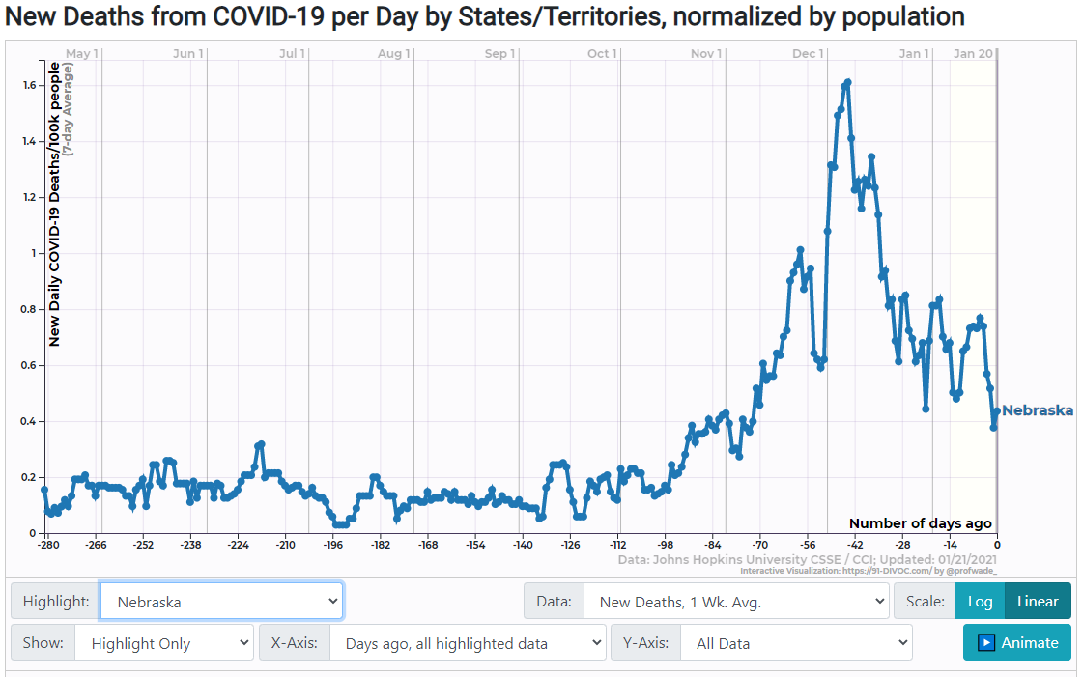
Nebraska
Statewide order: No
Masks are required for both clients and staff at barbershops, salons and other personal-care businesses. They are recommended for restaurant employees and for the general population when in public. Lincoln and Omaha have enacted broader local orders that require face-covering in most indoor public places. Other cities and towns have weighed mask orders but Gov. Pete Ricketts has questioned whether they have authority to enact them under state law.
**No Shutdowns

Slide 30
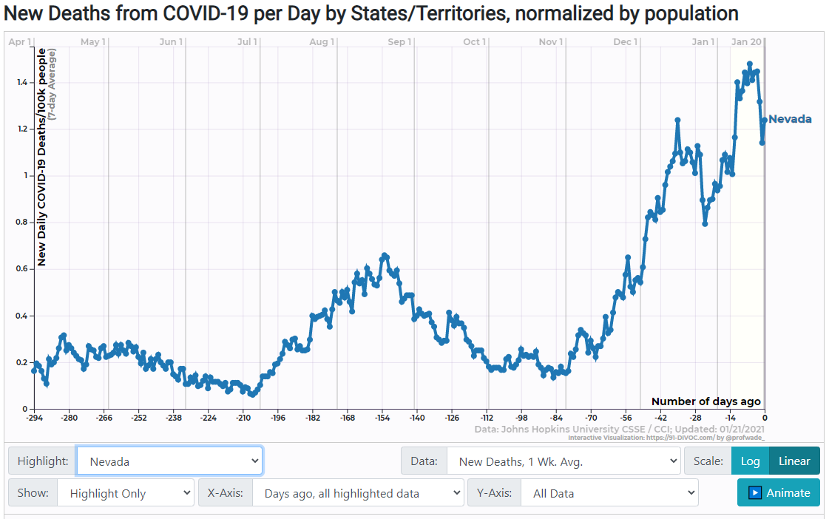
Nevada
Statewide order: Yes
Gov. Steve Sisolak instituted a mandatory face-covering policy on June 24, requiring most people over age 9 to wear a mask “in any public space.”

Slide 31
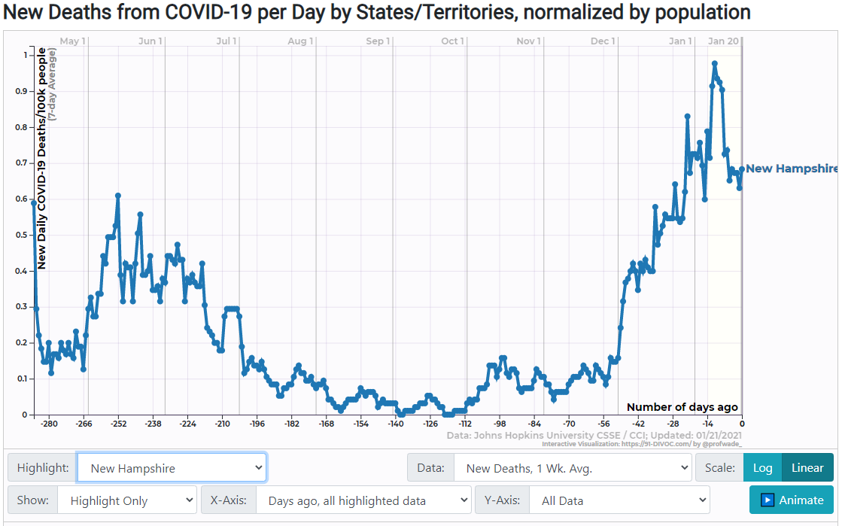
New Hampshire
Statewide order: Yes
Gov. Chris Sununu's emergency order, effective Nov. 20, requires people over age 5 to wear masks in all public spaces, indoors and out, if they are unable to maintain 6 feet of distance from people outside their households. K-12 schools are exempt. The order expands a previously patchwork set of mask rules that applied only to large gatherings and certain businesses. It took effect on Nov. 20 and has been extended through at least March 26.

Slide 32
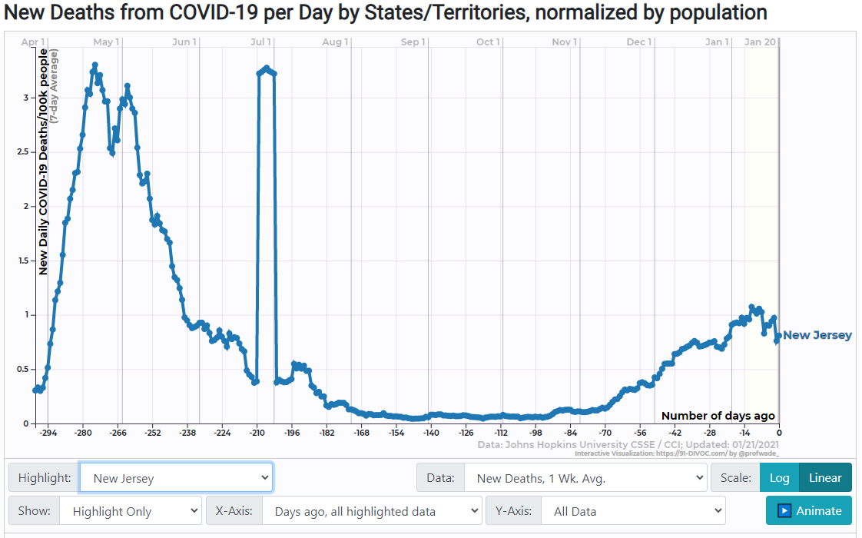
New Jersey
Statewide order: Yes
Gov. Phil Murphy's executive order of July 8 mandates face covering in indoor and outdoor public spaces for anyone over age 2. Separate state orders require construction and agricultural workers to wear masks on the job.

Slide 33
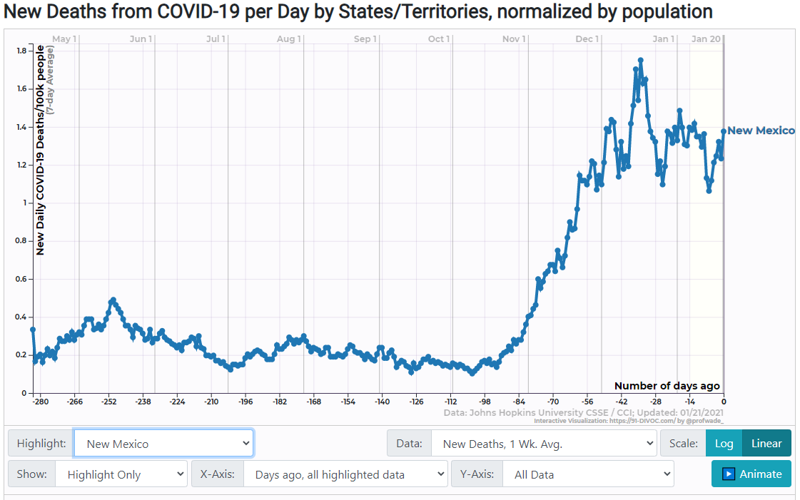
New Mexico
Statewide order: Yes
New Mexico has had a mask requirement in place since May 16. Unlike in most states, it applies to people while exercising in gyms, a restriction Gov. Michelle Lujan Grisham added in July. She has ordered that the state “aggressively enforce” the rule, with violators subject to a $100 fine and retailers required to ensure customers are wearing masks.

Slide 34
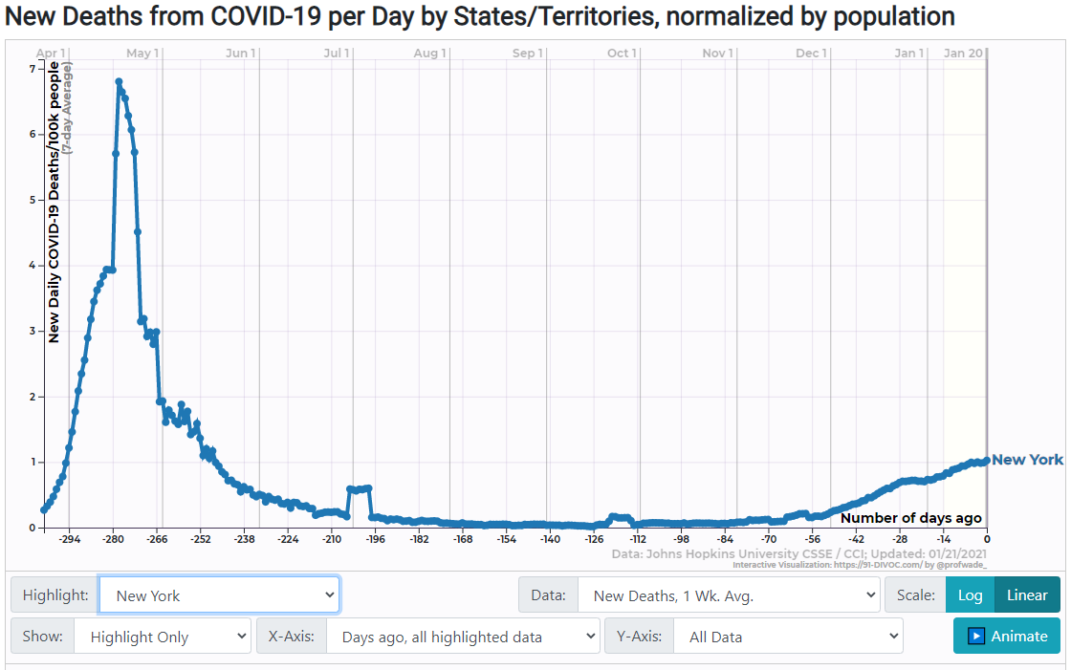
New York
Statewide order: Yes
New York has had a mask requirement since April 17. Gov. Andrew Cuomo's order applies to anyone over age 2 who can “medically tolerate a face covering” when in a public place and unable to maintain social distancing.

Slide 35
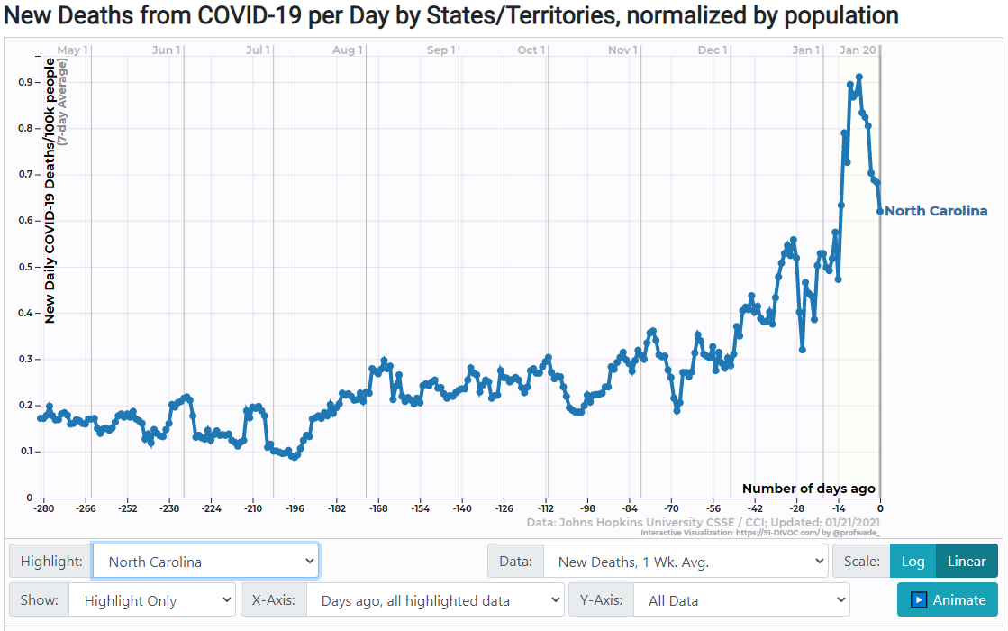
North Carolina
Statewide order: Yes
Gov. Roy Cooper expanded the state's mask mandate, in effect since June, in a Nov. 23 executive order. People over age 5 are now required to wear a face covering in any indoor space where someone from another household is present, regardless of physical distancing, and outdoors if it is not possible to stay 6 feet from others.

Slide 36
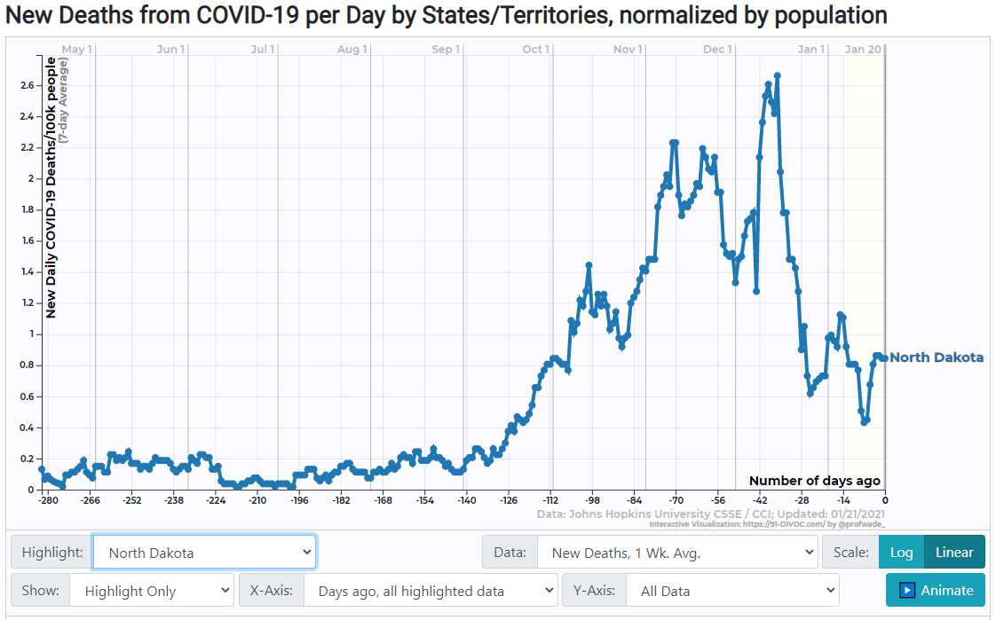
North Dakota
Statewide order: No
Gov. Doug Burgum instituted a statewide mask requirement on Nov. 14 amid a rapid rise in the state’s COVID-19 case count. After extending the mandate in December, Burgum allowed it to lapse when it expired Jan. 18, citing a decline in case numbers. Most of North Dakota’s largest cities, including Fargo, Bismarck and Minot, have face-covering orders in place.
**No Shutdowns

Slide 37
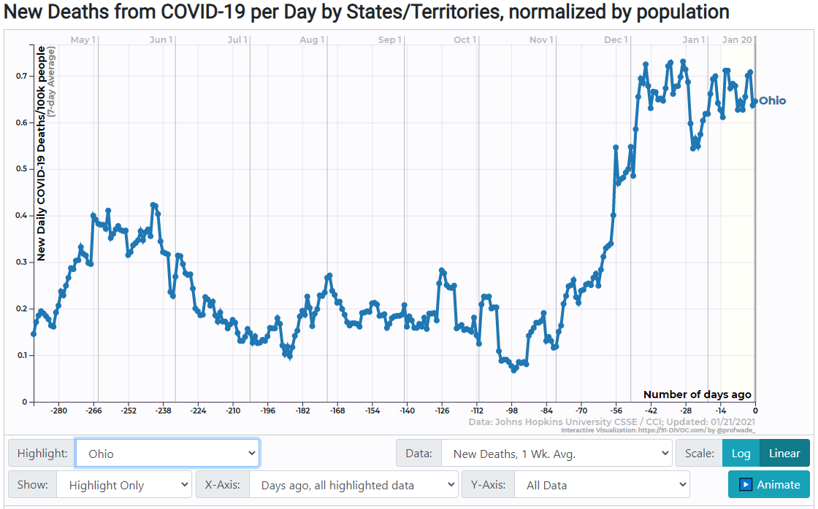
Ohio
Statewide order: Yes
The state mandate took effect July 23, replacing an alert system in which mask orders were imposed on individual counties deemed to be at high risk for coronavirus spread. Gov. Mike DeWine’s directive applies to people age 10 and older when in public indoor spaces and outdoors when unable to maintain 6-foot social distancing.

Slide 38
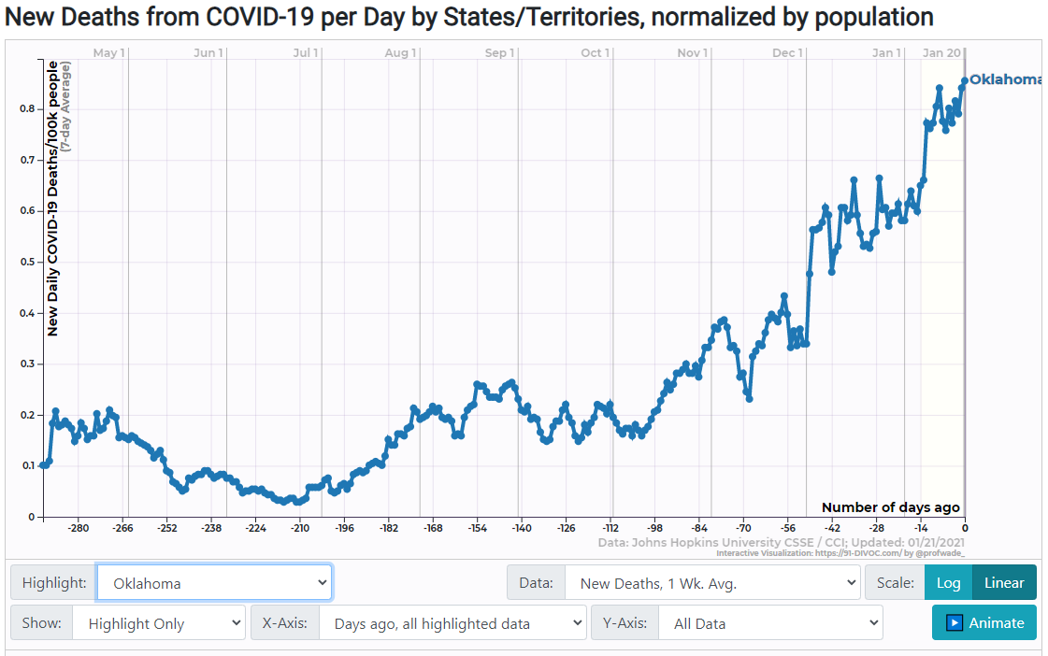
Oklahoma
Statewide order: No
Gov. Kevin Stitt, who recovered from a bout of COVID-19 in July, has called on Oklahomans to wear masks in public but rejected calls for a state mandate. A few cities, including Tulsa, have adopted mask requirements.

Slide 39
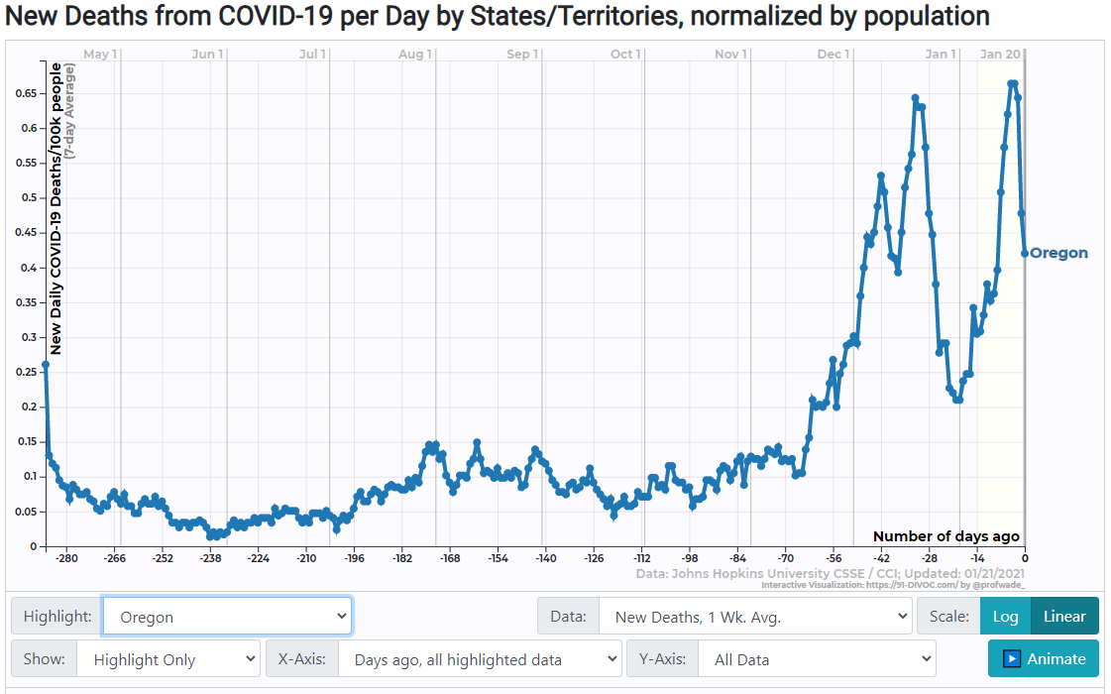
Oregon
Statewide order: Yes
Gov. Kate Brown implemented a state mask rule on July 1, covering indoor public spaces. It has since been expanded to cover all workplaces, including offices, and outdoor businesses and public spaces when physical distancing is not possible. Children under 5 are exempt, but the state recommends face coverings for children as young as 2. Indoor gatherings of more than 10 people are prohibited.

Slide 40
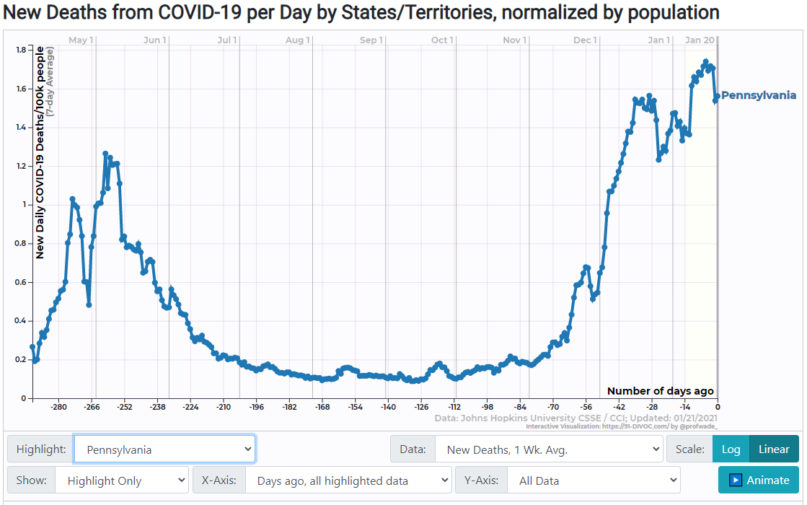
Pennsylvania
Statewide order: Yes
Pennsylvania mandates "universal face coverings" under a Nov. 18 order from state Health Secretary Rachel Levine, which strengthened a mask order that had been in effect since July 1. The new policy requires people age 2 and up to cover their faces indoors (including in homes) when people from other households are present, even if they can stay 6 feet apart, and at all times outdoors when unable to maintain physical distancing.

Slide 41
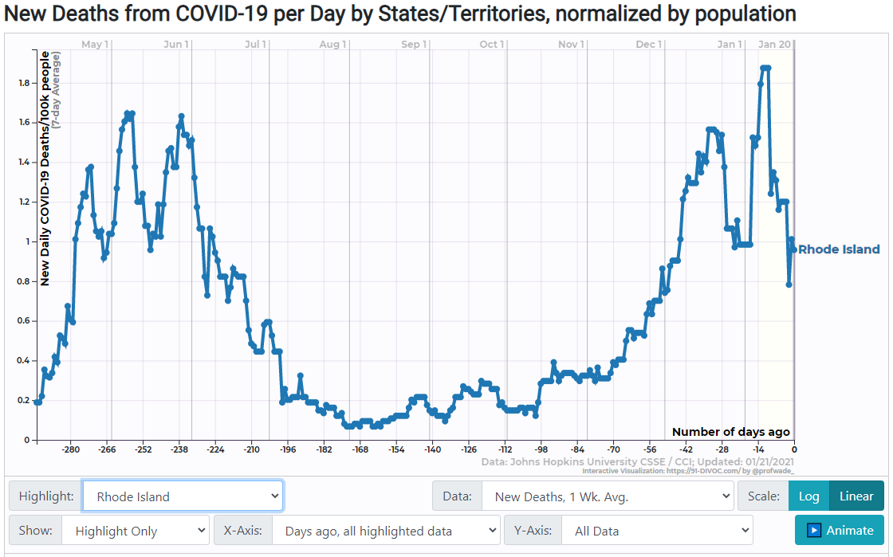
Rhode Island
Statewide order: Yes
Masks have been mandatory since May 8 under Gov. Gina Raimondo's executive order, which requires face coverings for people over age 2 in retail outlets, and in other public spaces unless they “can easily, continuously, and measurably maintain at least 6 feet of distance from other people."

Slide 42
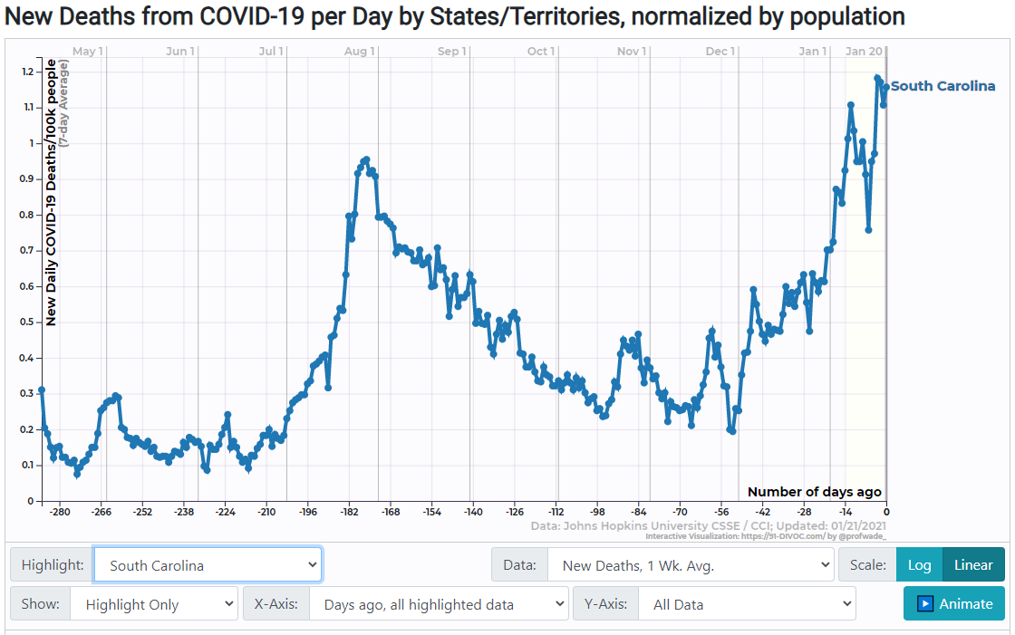
South Carolina
Statewide order: No
Numerous counties and cities, including Charleston and Columbia, have instituted mask mandates. Gov. Henry McMaster has encouraged masking but says a state requirement would be unenforceable. State guidelines encourage reopening businesses to have employees wear masks, “especially when in settings in which social distancing is not feasible."

Slide 43
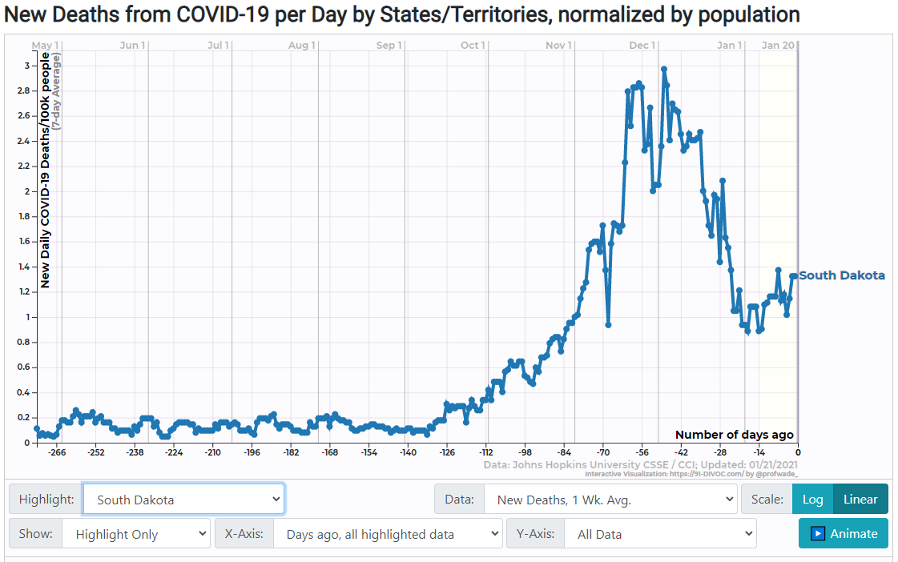
South Dakota
Statewide order: No
The South Dakota Department of Health recommends “wearing cloth face coverings in public settings where other social distancing measures are difficult to maintain, especially in areas of significant community-based transmission.“
**No Shutdowns

Slide 44
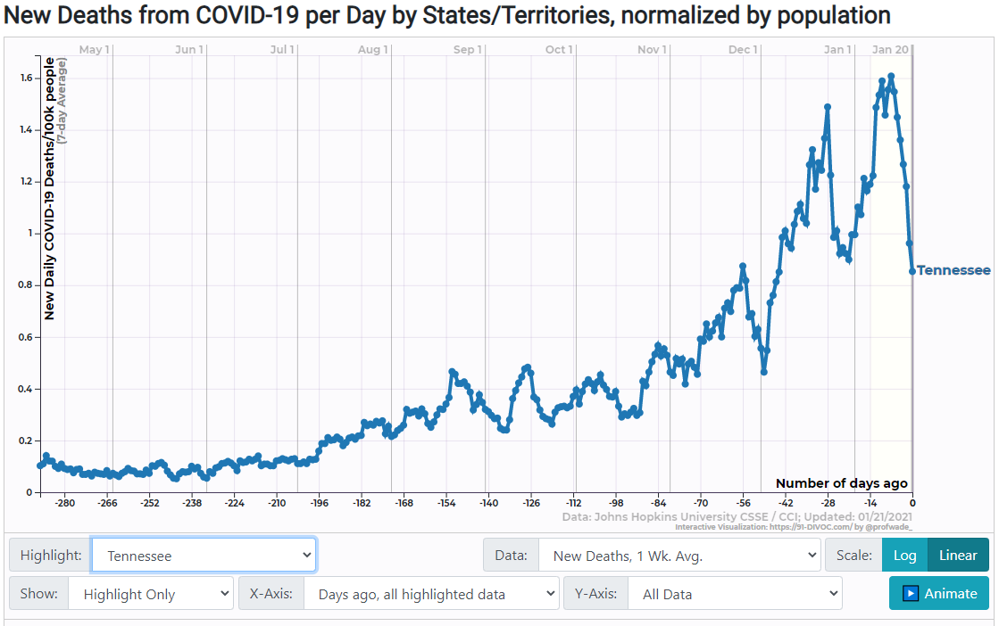
Tennessee
Statewide order: No
An April 28 executive order from Gov. Bill Lee urges people to “wear face coverings in public places,” as do state health guidelines. Jurisdictions covering about 70 percent of the state's population have enacted local mask mandates, including the counties that are home to Nashville, Memphis, Knoxville and Chattanooga.

Slide 45
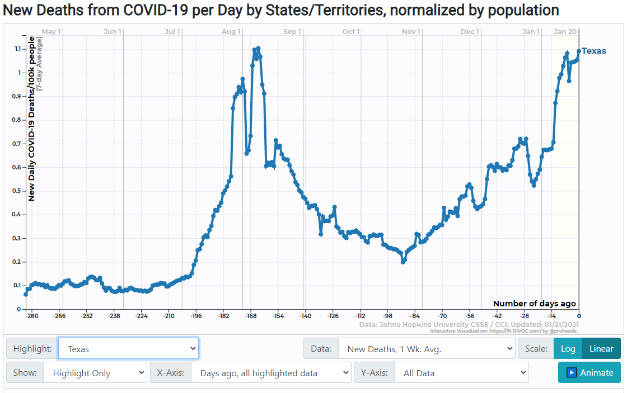
Texas
Statewide order: Yes
Gov. Greg Abbott’s mask order took effect July 3. Children under 10 are excepted. Counties with 20 or fewer active COVID-19 cases can apply to the state for exemption. As of Jan. 13, 18 of the state’s 254 counties had exemptions due to low case counts.

Slide 46
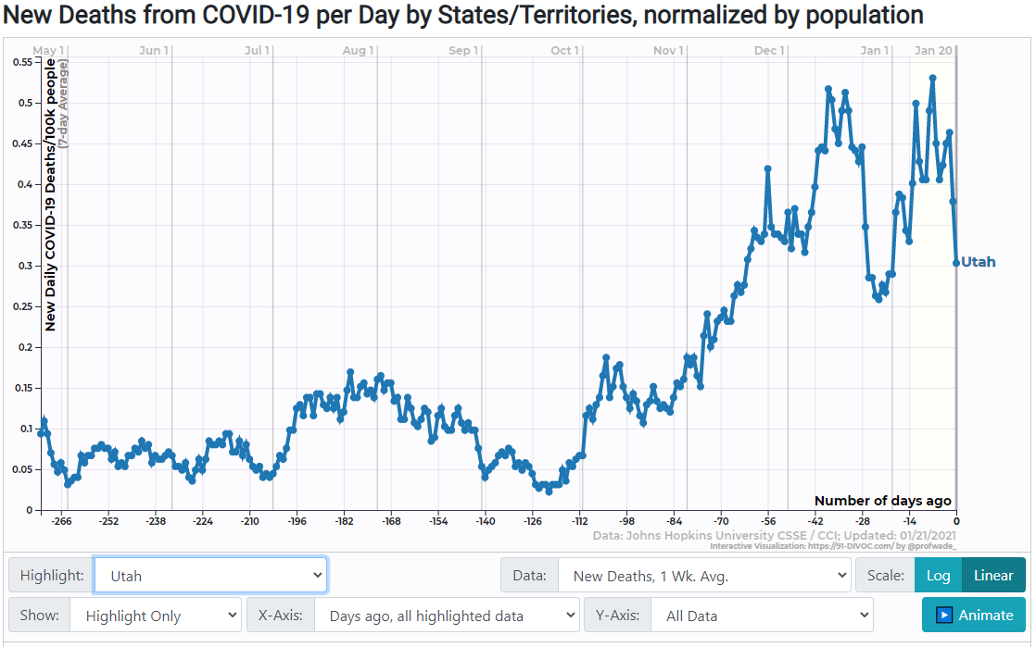
Utah
Statewide order: Yes
Gov. Gary Herbert announced a statewide mask requirement as part of a new emergency declaration that took effect Nov. 9, replacing a system of state-imposed, county-level mask mandates based on local COVID-19 transmission rates. It requires people over the age of 2 to wear a face covering in public and whenever they are within 6 feet of someone from a separate household. It is in effect through at least Jan. 21.

Slide 47
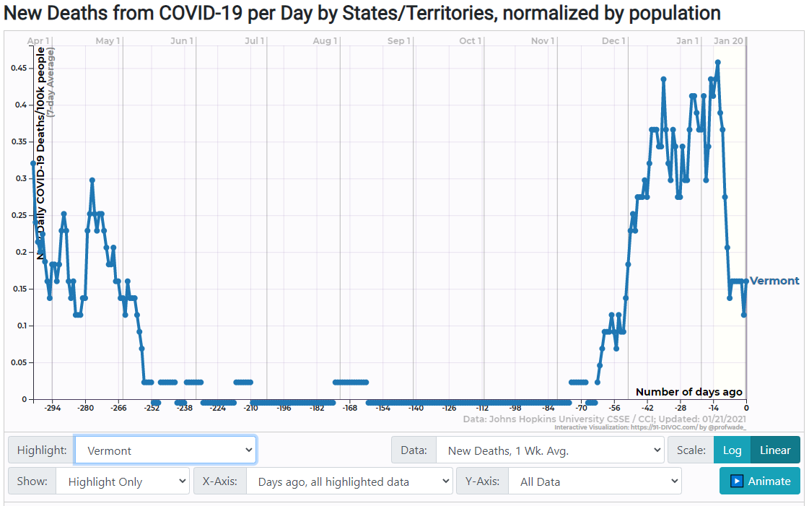
Vermont
Statewide order: Yes
Gov. Phil Scott’s mask directive took effect Aug. 1 and has been extended several times since. It applies to Vermonters age 2 and up whenever they are in public settings, indoors or outdoors, “wherever close contact is unavoidable.”

Slide 48
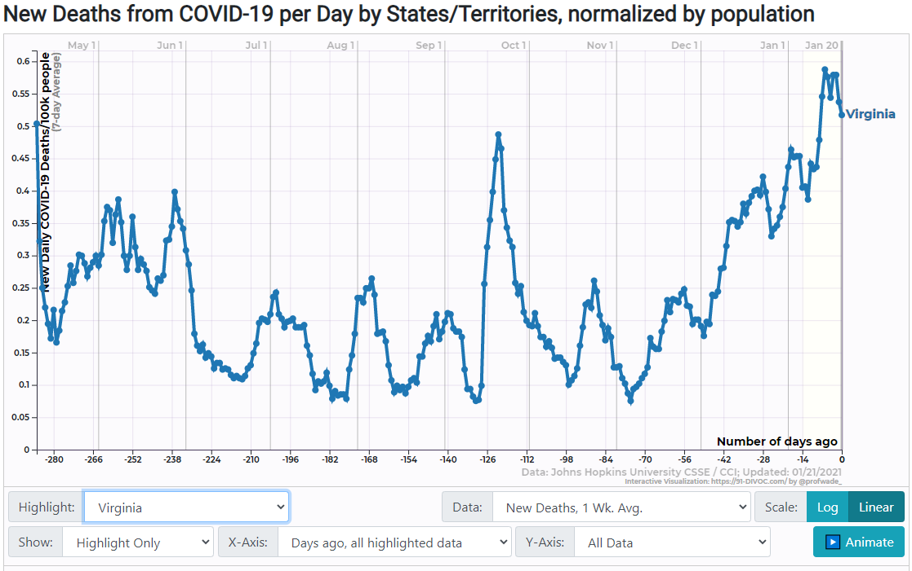
Virginia
Statewide order: Yes
Effective Dec. 14, Virginians age 5 and up must wear masks in retail and commercial businesses and other indoor settings "shared with others," and outdoors when unable to maintain 6 feet of distance from people outside their families, under an executive order by Gov. Ralph Northam. A previous mask order issued in May and amended in November only applied to indoor public settings. The latest order is in force through Jan. 31, 2021.

Slide 49
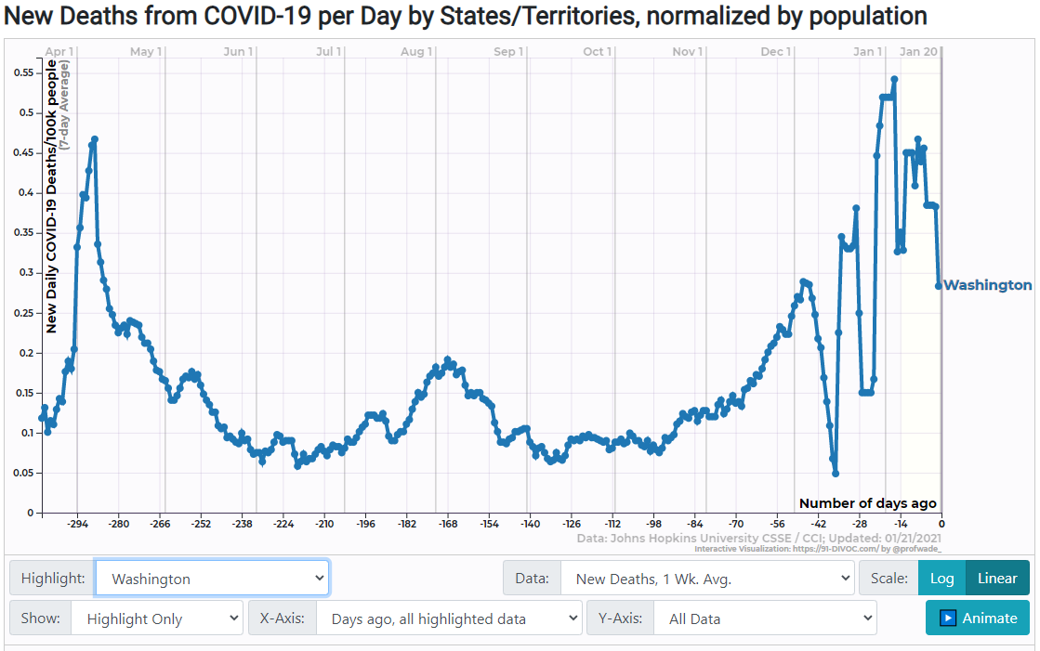
Washington
Statewide order: Yes
A state public health order that took effect June 26 requires mask use in indoor public settings and outdoors when 6-foot distancing cannot be maintained, for people age 5 and older. Gov. Jay Inslee's mask directives also mandate that businesses require employees to wear face coverings and deny entry to unmasked customers.

Slide 50
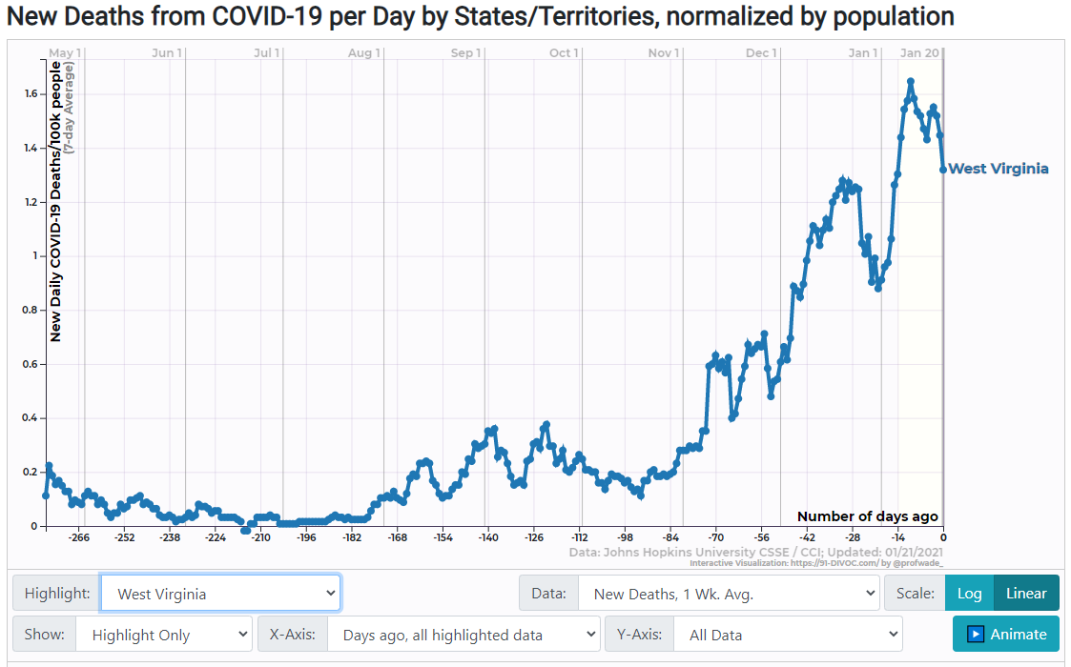
West Virginia
Statewide order: Yes
Gov. Jim Justice tightened West Virginia's mask mandate on Nov. 14 to require that people age 9 and up wear face coverings at all times in indoor public spaces, except when in the act of eating or drinking at a restaurant. The previous order, which had been in effect since early July, allowed people to remove masks indoors if they could maintain adequate social distance from others.

Slide 51
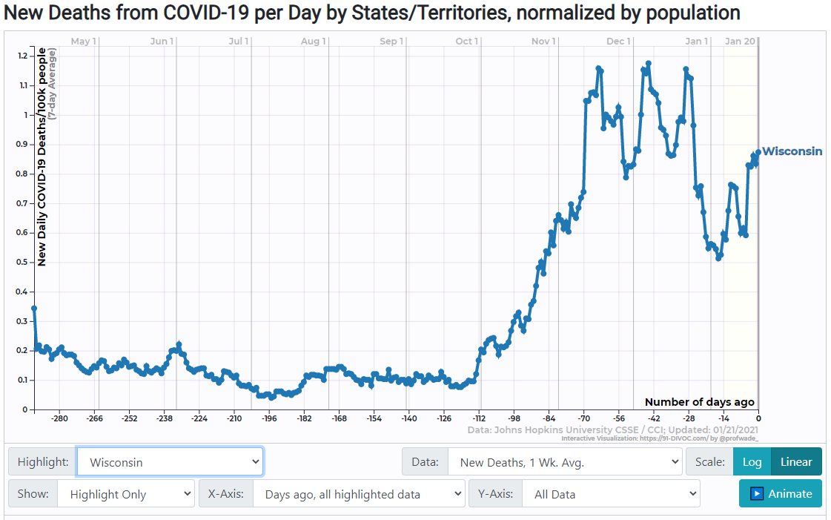
Wisconsin
Statewide order: Yes
Gov. Tony Evers' emergency order mandating face-covering took effect Aug. 1 and, following multiple extensions, will be in force until at least mid-March. It applies to people ages 5 and up in all indoor public settings, and in “enclosed spaces” such as park structures and outdoor restaurant seating, when someone from another household is present.

Slide 52
Wyoming
Statewide order: Yes
Starting Dec. 9 and running through at least Jan. 25, face-covering is required statewide in most indoor public settings, including retail and commercial businesses, government buildings and health care facilities, and when waiting in line to enter such places. Previously, Wyoming mandated masks only for workers at certain businesses if they came within 6 feet of patrons or colleagues. Children under 12 are exempt, but masking is encouraged for kids aged 3 to 11.
**No Shutdowns

Slide 53
SUMMARY
State | Highest Rate | Lowest Rate | Average Rate | Mask Mandate (Y/N)
Alabama

Slide 54
https://wwwnc.cdc.gov/eid/article/26/7/20-0282_article
https://www.aarp.org/health/healthy-living/info-2020/states-mask-mandates-coronavirus.html#Georgia
https://91-divoc.com/pages/covid-visualization/

